Slide 1




Manufacturing Project
By Mohamed Emad

Slide 2



Analysis / Dashboard
Project Wireframe
Dashboard
Dashboard

Slide 3
Manufacturing Project
Project Idea

Slide 4
Problem description
Project Idea
Proposed solution
Unique value proposition

Slide 5
Problem description
Unique value proposition
Proposed solution
Project Idea

Slide 6
Problem description
Project Idea
Proposed solution
Unique value proposition

Slide 7
Proposed solution
Unique value proposition
Problem description
Project Idea

Slide 8
Problem description
Project Idea
Proposed solution
Unique value proposition

Slide 9
Unique value proposition
Problem description
Proposed solution
Project Idea

Slide 10
Problem description
Project Idea
Proposed solution
Unique value proposition

Slide 11
Manufacturing Project
Project Idea

Slide 12
Manufacturing Project
Project Wireframe

Slide 13
Manufacturing Project
Project Team + Roles

Slide 14

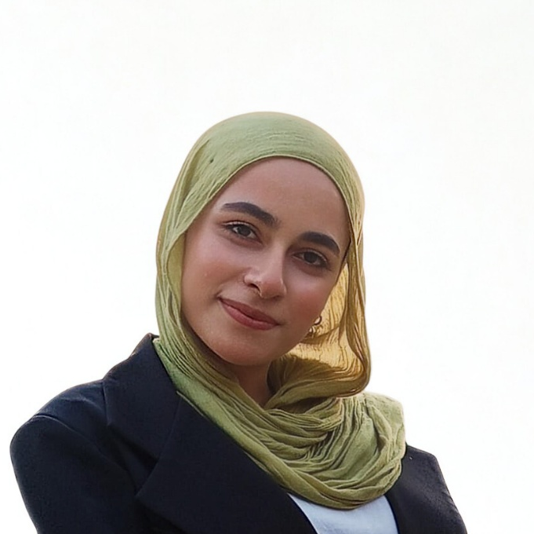



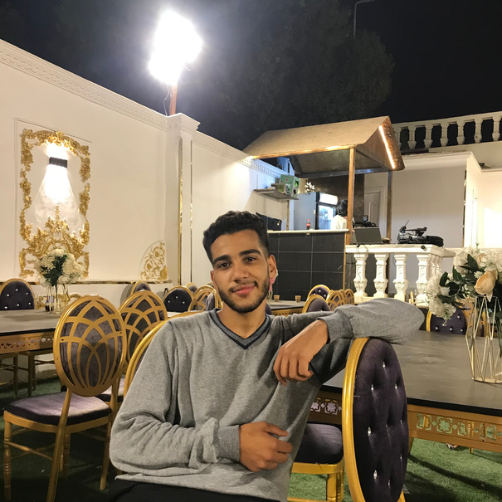

Project Team + Roles

Slide 15
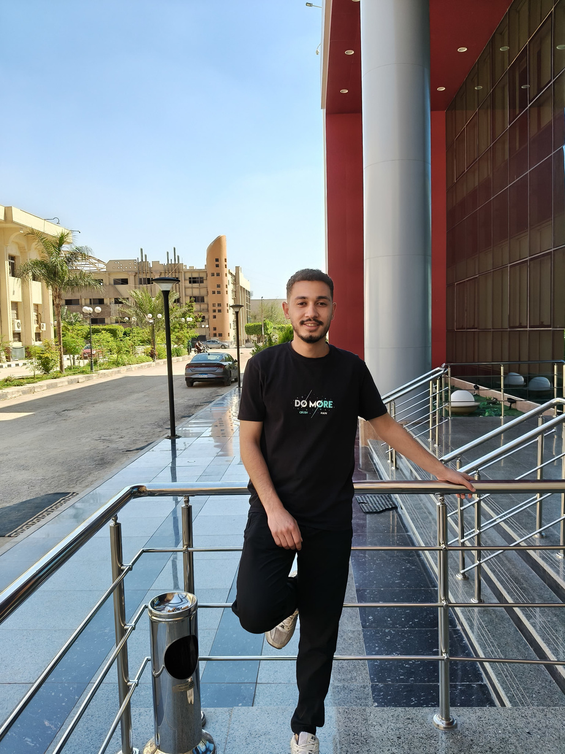
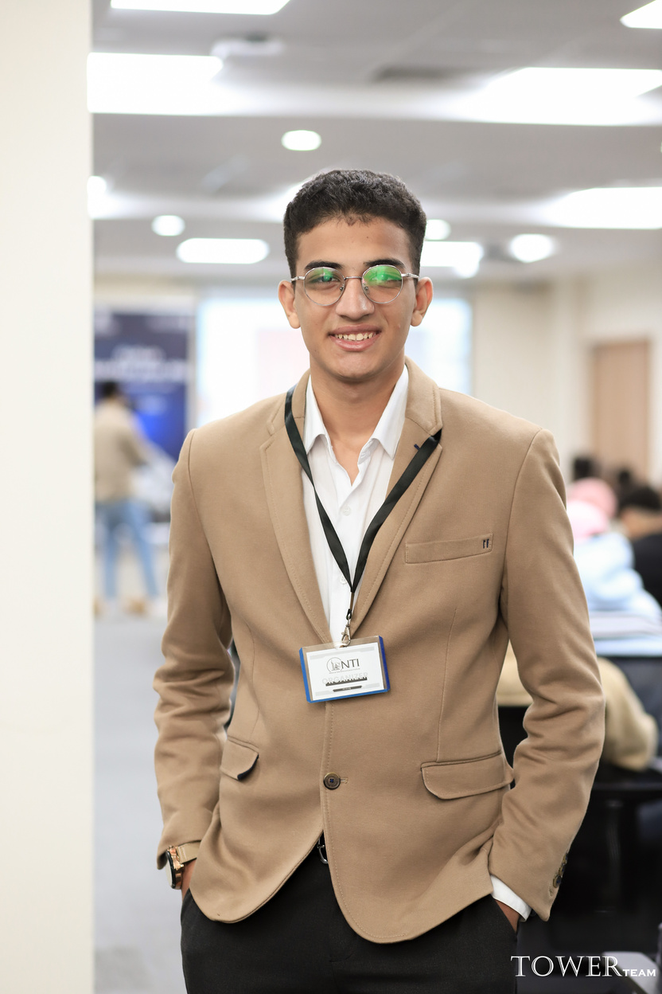
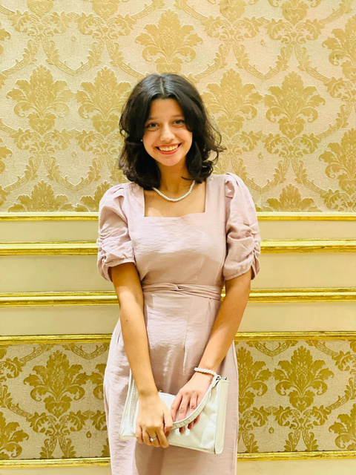

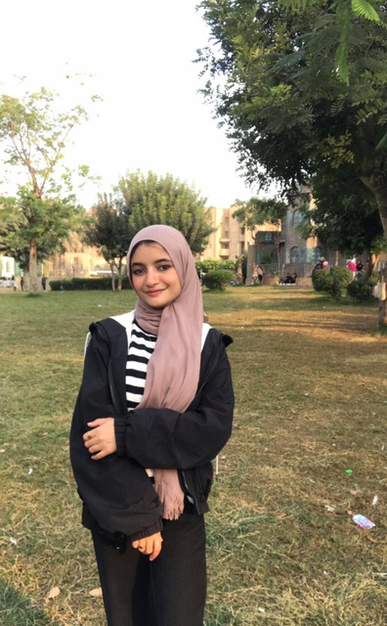

Project Team + Roles
Mohamed Emad Ramadan
Introduction
I’m Mohamed Emad, a 20-year-old student at Al-Azhar University’s Faculty of Agriculture. Passionate about analytical thinking and leveraging technology to solve complex problems. Currently exploring innovative ways to bridge data-driven insights with real-world applications in the agricultural field.
Team Leader
Data Insights Specialist
– Data analysis and insights generation
– Supporting the team in extracting and refining final insights
– Data analysis using Excel (Pivot Tables + Charts)

Slide 16

Project Team + Roles
Menna Younes
Introduction
I am a third-year MIS student at Helwan University (English Section). I specialize in integrating technology with business strategies. My focus is on optimizing operational efficiency through digital transformation and providing actionable, data-driven insights to enhance decision-making..
Role
Data Insights Specialist
– Data analysis and insights generation
– Supporting the team in extracting and refining final insights
– Data analysis using Excel (Pivot Tables + Charts)

Slide 17
Project Team + Roles
Mohamed Elsayed Mohamed
Introduction
Mohamed Elsayed Mohamed, is a 23-year-old, a Telecommunications & Electronics Engineering student passionate about Data Analytics. Skilled in the full data lifecycle including data cleaning, modeling, and building professional dashboards using Excel and Power BI to turn raw data into actionable insights.
Role
Data Insights Specialist
– Data analysis and insights generation
– Supporting the team in extracting and refining final insights
– Data analysis using Excel (Pivot Tables + Charts)

Slide 18
Project Team + Roles
Farah Magdy
Introduction
Farah Magdy A 19 years old student at Cairo University and Georgia State University joint program. Specializing in Data Analysis and Marketing, I am passionate about transforming raw data into actionable business insights and creative branding strategies. I am dedicated to continuous technical growth and professional excellence.
Role
Data Insights Specialist
– Data analysis and insights generation
– Supporting the team in extracting and refining final insights
– Data analysis using Excel (Pivot Tables + Charts)

Slide 19
Project Team + Roles
Mohamed Ahmed Abubakr
Introduction
Mohamed Ahmed Abubakr, l’m 20 years old. Intelligent Systems Engineering student at Helwan National University (HNU) specializing in Data Analytics and Business Intelligence. Experienced in analyzing complex datasets and transforming them into clear, interactive visualizations using Power BI and Excel, enabling better understanding of data, uncovering hidden insights, and supporting strategic decision.
Data Insights Specialist
– Data analysis and insights generation
– Supporting the team in extracting and refining final insights
– Data analysis using Excel (Pivot Tables + Charts)

Slide 20

Thanks for your time :)

